Slide 1
ICU Trauma
James Booker

Slide 2
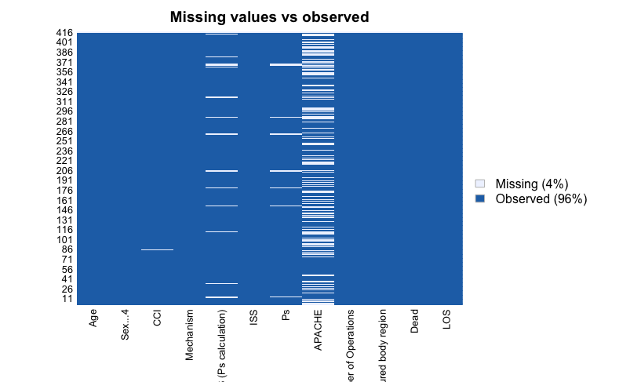
Assess missing data
Most of missing data found in APACHE variable

Slide 3
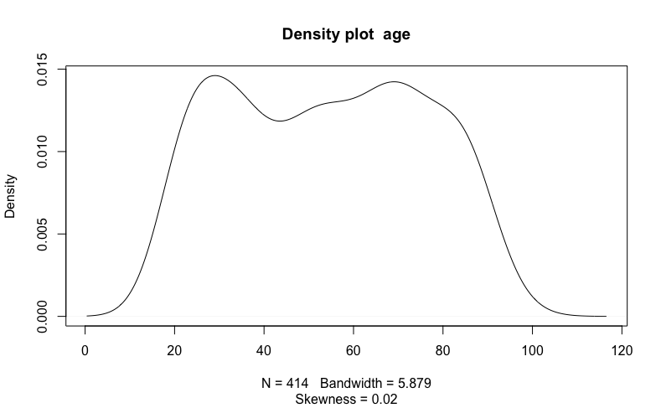
Assess distribution of variables

Slide 4
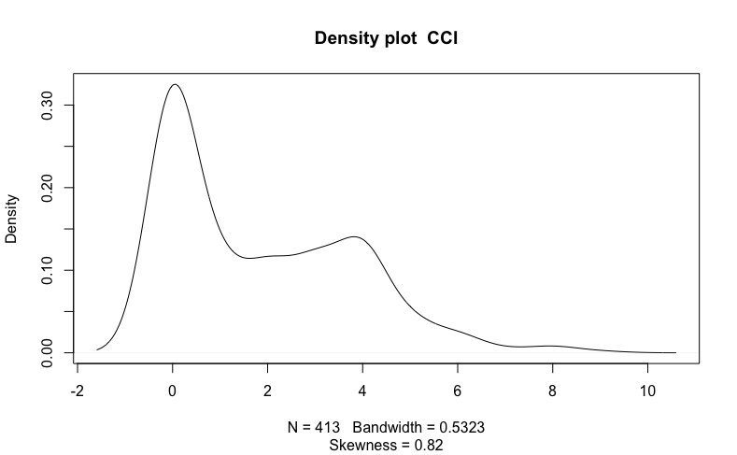
Assess distribution of variables

Slide 5
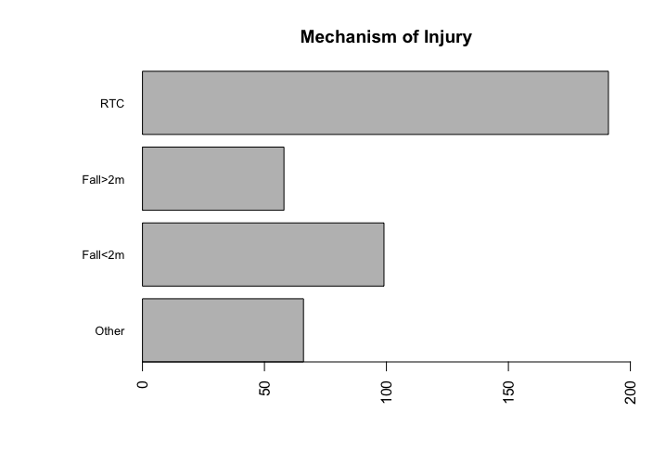
Assess distribution of variables

Slide 6
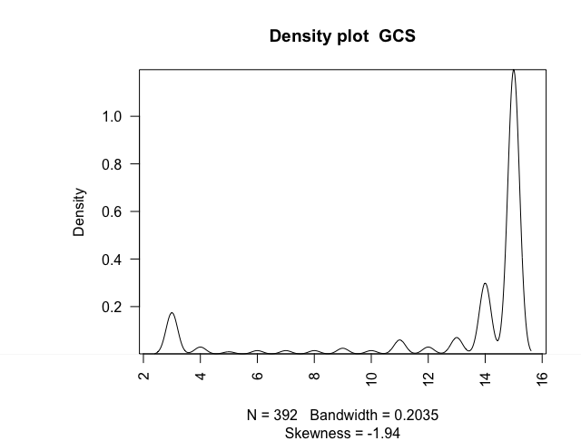
Assess distribution of variables

Slide 7
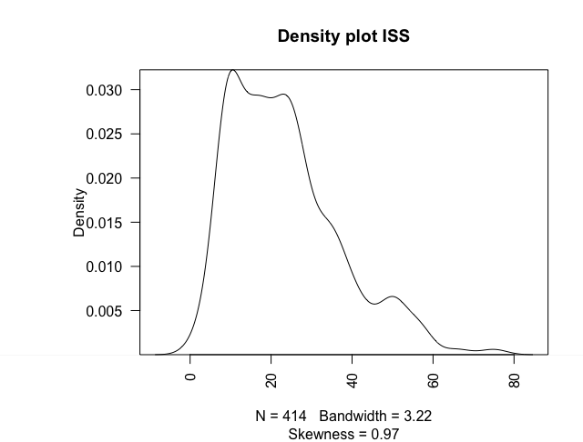
Assess distribution of variables

Slide 8
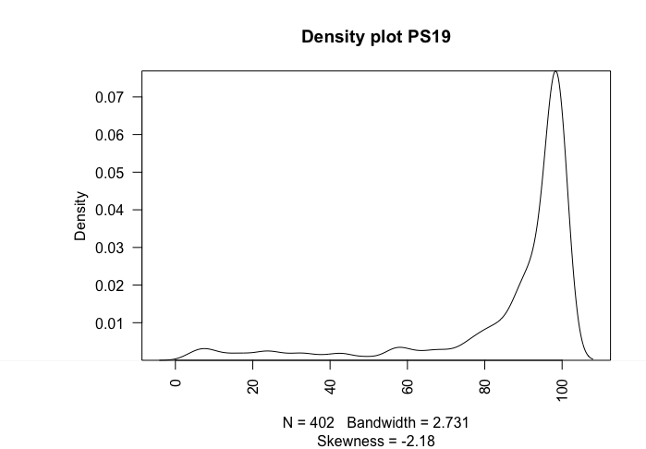
Assess distribution of variables

Slide 9
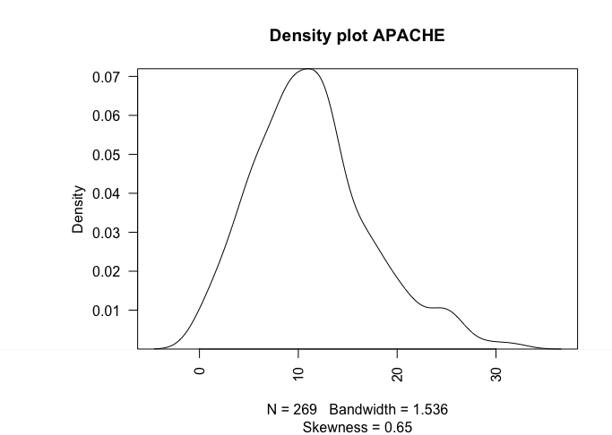
Assess distribution of variables

Slide 10
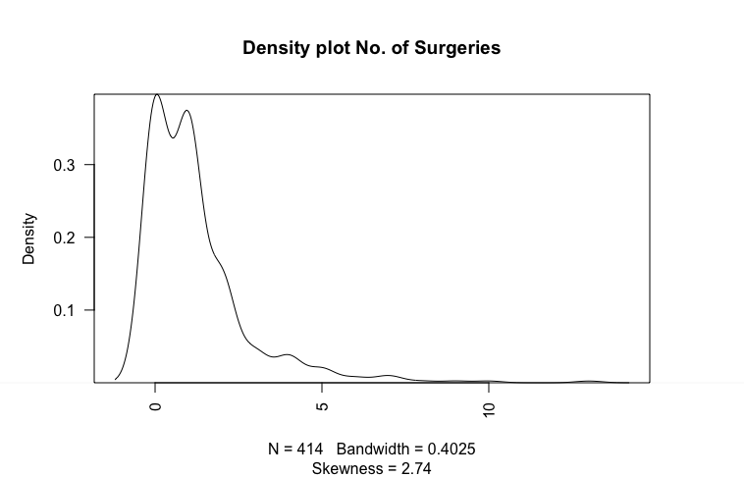
Assess distribution of variables

Slide 11
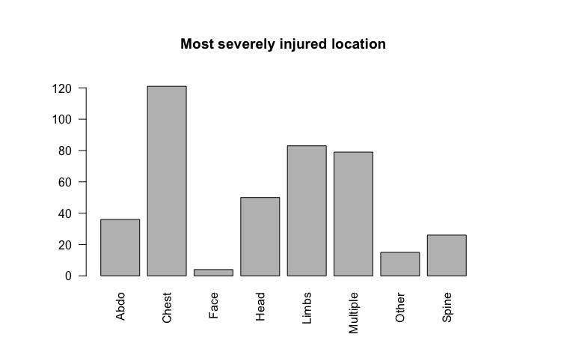
Assess distribution of variables

Slide 12
Many skewed variables that could be log transformed to create a normal distribution or dichotomized

Slide 13
Transform variables
GCS 15 and <15
APACHE 0-10, 11-20, 21-30, NA
PS19 >81, 61-80, 41-60, 21-40, 0-20
ISS 1-20, 21-40, 41-60, 61-80

Slide 14
Univariate analysis
Univariate analysis on variables that were significantly different between the survivor and
Non-survivor groups
Method – logistic regression predicting death

Slide 15
Univariate analysis
Predictor | Estimate | Standard error | Z value | P value | OR (CI)
Age | 0.0437 | 0.00710 | 6.15 | <0.001*** | 1.04 (1.03-1.06)
Charlson Comorbidity index | 0.0980 | 0.0618 | 1.59 | 0.122 | 1.10 (0.98-1.24)
Mechanism of injury RTC Fall>2m Fall<2m Other | 0ª 0.371 1.15 0.436 | 0ª 0.411 0.308 0.387 | 0ª 0.905 3.75 1.13 | 0ª 0.366 <0.001*** 0.260 | 0ª 1.45 (0.624-3.17) 3.17 (1.74-5.84) 1.55 (0.705-3.25)
Glasgow Coma Score (GCS) 15 <15 | 0ª 1.33 | 0ª 0.279 | 0ª 4.77 | 0ª <0.001*** | 0ª 3.79 (2.21-6.63)
Injury Severity Score (ISS) 1-20 21-40 41-60 61-80 | 0ª 0.541 1.13 1.89 | 0ª 0.285 0.378 1.02 | 0ª 1.90 3.00 1.85 | 0ª 0.0580 0.00269** 0.0645 | 0ª 1.72 (0.985-3.02) 3.10 (1.46-6.46) 6.62 (0.767-57.1)
Probability of Survival (Ps19) 81-100 61-80 41-60 21-40 0-20 | 0ª 2.18 3.51 2.81 5.33 | 0ª 0.420 0.569 0.549 1.05 | 0ª 5.18 6.17 5.12 5.06 | 0ª <0.001*** <0.001*** <0.001*** <0.001*** | 0ª 8.81 (3.82-20.1) 33.5 (11.6-112) 16.5 (5.68-50.3) 206 (39.4-3800)
APACHE II 0-10 11-20 21-30 | 0ª 0.648 0.638 | 0ª 0.406 0.701 | 0ª 1.60 0.910 | 0ª 0.110 0.363 | 0ª 1.91 (0.874-4.36) 1.89 (0.399-6.83)
Number of surgeries | -0.466 | 0.139 | -3.35 | 0.001*** | 0.627 (0.467-0.806)
Most severely injured body region Chest Head Face Spine Abdomen Multiple Limbs Other | 0ª 2.41 -13.2 0.702 -0.426 0.956 0.723 2.54 | 0ª 0.435 728 0.636 0.799 0.437 0.448 0.614 | 0ª 5.54 -0.018 1.10 0.533 2.19 1.62 4.14 | 0ª <0.001*** 0.986 0.270 0.594 0.0288* 0.106 0.001*** | 0ª 11.1 (4.87-27.1) 0 (0-2x10³⁰) 2.02 (0.517-6.66) 0.653 (0.0973-2.63) 2.60 (1.12-6.31) 2.06 (0.861-5.07) 12.7 (3.84-44.0)
*p<0.05 ***p<0.001 0ª, Reference category.
Notes:
More surgeries is protective of mortality – doesn’t make sense to me
Fall from <2m highly significant of mortality – also not sure why that would be

Slide 16
Multivariate analysis
Use variables that have been used for ROC AUC curves
Age
ISS
APACHE
GCS
Ps19
Number of surgeries
Method – logistic regression

Slide 17
Multivariate analysis
Prior to analysis carry out correlation matrix to identify collinearity between variables

Slide 18
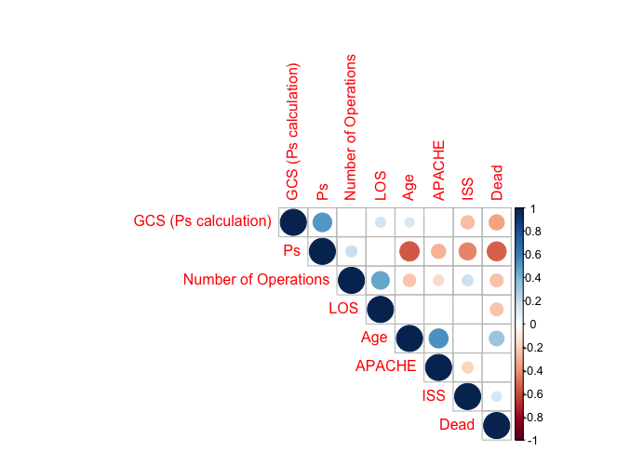
Multivariate analysis
Method = Spearman
Blank cells = insignificance p>0.01
Plot shows scoring tools are highly collinear

Slide 19
Multivariate analysis
APACHE removed as a variable due to missing data

Slide 20
Multivariate analysis 1
Predictor | Estimate | Standard error | Z value | P value | OR (CI)
Age | 0.0569 | 0.00959 | 5.94 | <0.001*** | 1.06 (1.04-1.08)
Glasgow Coma Score (GCS) 15 <15 | 1.98 | 0.337 | 5.86 | <0.001*** | 7.21 (3.80-14.3)
Mechanism of injury RTC Fall>2m Fall<2m Other | 0ª -0.111 0.325 0.625 | 0ª 0.488 0.393 0.472 | 0ª -0.228 0.827 1.32 | 0ª 0.819 0.408 0.185 | 0ª 0.895 (0.330-2.27) 1.38 (0.639-3.01) 1.87 (0.727-4.69)
Number of surgeries | -0.0313 | 0.150 | -0.208 | 0.835 | 0.969 (0.708-1.28)
*p<0.05 ***p<0.001 0ª, Reference category.

Slide 21
Multivariate analysis 2
Predictor | Estimate | Standard error | Z value | P value | OR (CI)
Age | 0.0609 | 0.00977 | 6.23 | <0.001*** | 1.06 (1.04-1.08)
Glasgow Coma Score (GCS) 15 <15 | 0ª 1.50 | 0ª 0.371 | 0ª 4.04 | 0ª <0.001*** | 4.47 (2.18-9.40)
Most severely injured body region Chest Head Face Spine Abdomen Multiple Limbs Other | 0ª 1.99 -13.9 0.419 1.13 1.40 0.934 2.62 | 0ª 0.534 1150 79.8 0.890 0.526 0.527 0.777 | 0ª 3.73 -0.012 0.525 1.26 2.66 1.77 3.38 | 0ª <0.001*** 0.990 0.600 0.206 <0.001*** 0.0772 <0.001*** | 0ª 7.33 (2.64-21.7) 0.00 (0.00-0.00) 1.52 (0.272-6.72) 3.08 (0.408-15.6) 4.06 (1.47-1.18) 2.54 (0.912-7.34) 13.8 (3.06-65.7)
Number of surgeries | -0.188 | 0.141 | -1.33 | 0.184 | 0.829 (0.612-1.07)
*p<0.05 ***p<0.001 0ª, Reference category.

Slide 22
Dominance analysis
Dominance analysis to assess the importance of each variable in the model and to identify collinearity

Slide 23
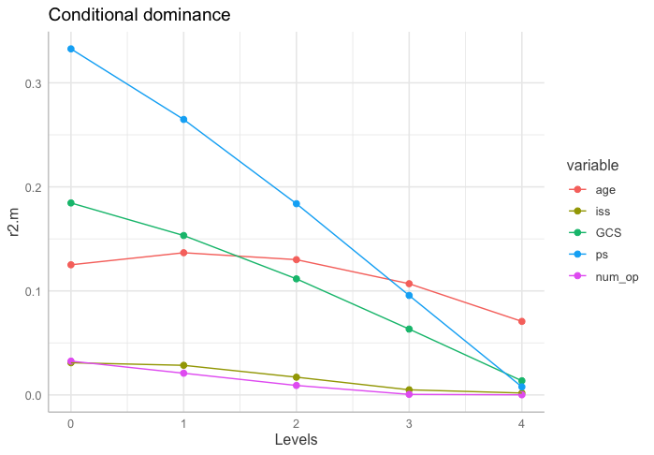
Dominance analysis
Ps19 is highly correlated with other scoring tools but as a univariate is highly significant

Slide 24
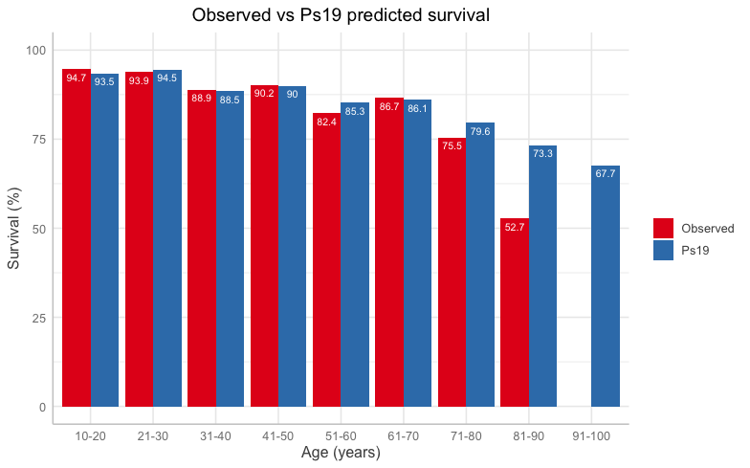

Slide 25
